Slide 1

Tracking Tracker Blockers: Privacy Software Review
Chris Choi
Bryan Van Draanen
Arthur Liang

Slide 2
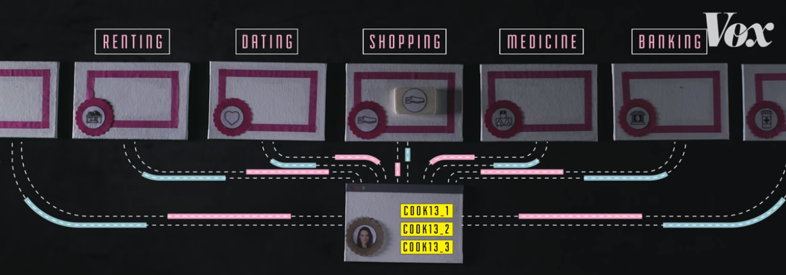
Problems/Motivation
How are we all tracked?
Websites and trackers have evolved
Cookies and trackers are often active without user consent
How pervasive are trackers on the internet?
How likely are specific trackers to be encountered?
How widespread are individual trackers?
What can we do to stop them?
Comparison of public extensions and browsers
Notes:
In benign cases, websites can save your preferences and show better recommendation when you visit next time
However, in more malicious cases, insurance companies could track down your search history of diseases and raise your insurance rates
We were curious about the extent to which users are tracked every day, and how privacy extentions and browsers can help protect users.

Slide 3




Goals
Compare effectiveness of privacy extensions and browsers against trackers on popular sites on the internet
Design and propose new metric for comparing blocking software
Evaluate best blockers for particular users and browsing behavior
Understand prevalence of trackers and their presence across websites

Slide 4
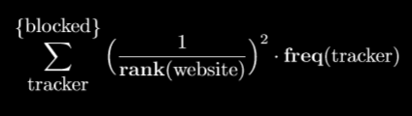
Metric
Best blockers stop prevalent trackers encountered on prominent websites
Score extensions by weighting frequency of blocked trackers with prominence of website (inverse of Alexa Top 50 rank) [1]
Emphasis on blocking pervasive trackers that appear on popular sites
Blocker score =
Website Prominence
Tracker Prevalence
Notes:
Mention how square of prominence is used instead of simply prominence in order to place less emphasis on blockers that block inane trackers (ones that appear only once on websites and basically contribute inverse ranking value to final score)

Slide 5
Results
Ghostery performed very well (confirmed with earlier research) [1]
PrivacyBadger blocks large volume of (obscure) trackers
Falls short by failing to block some of more prevalent trackers
uBlock Origin best according to our new metric
Blocked same pervasive trackers as Ghostery and more obscure trackers like PrivacyBadger
Firefox’s built in privacy performed poorly
Captured small portion of total trackers regardless of prevalence
Blocker | Score
Ghostery | 13.38
PrivacyBadger | 12.74
uBlock Origin | 17.52
Firefox | 7.64

Slide 6
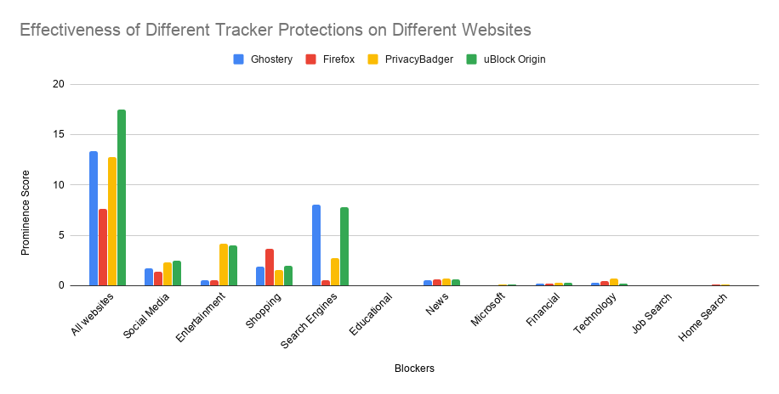
Comparison

Slide 7
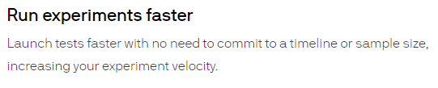

Domain Analysis
Analyzed domains and companies of blocked sites [3]
Google is most prevalent
Blocked domains might not just be for tracking
Notes:
AB Testing and security

Slide 8
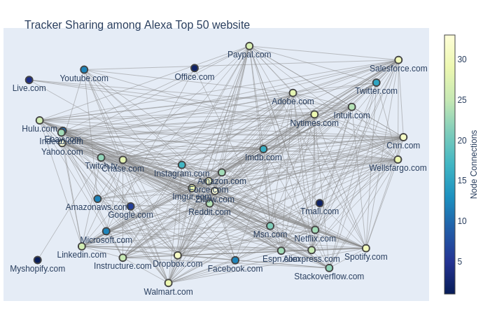
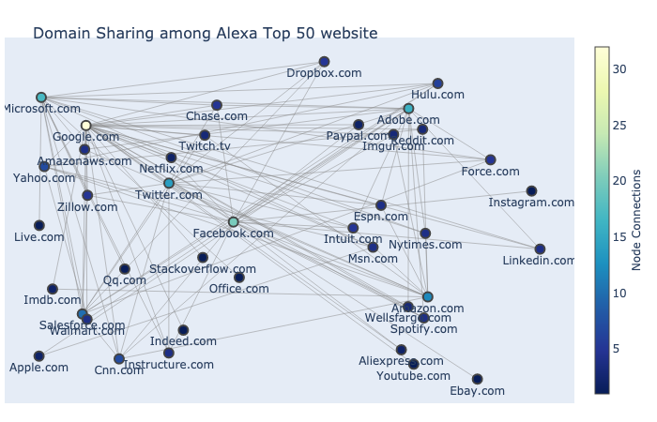
Connectivity Analysis
Tracker Sharing Connectivity Analysis: website A and B use the same tracker
Prevalence of sharing of user information
Domain Connectivity Analysis: website A uses a tracker that belongs to B
Big Tech most pervasive in collecting user information

Slide 9
Connectivity Analysis
Tracker Sharing Connectivity Analysis: website A and B use the same tracker
Prevalence of sharing of user information
Domain Connectivity Analysis: website A uses a tracker that belongs to B
Big Tech most pervasive in collecting user information
With any privacy protection software, the leak of user information between websites can be largely reduced

Slide 10
Conclusion
Metric provides high-level understanding of blocker effectiveness on prominent websites
Extensions that score higher block most pervasive trackers consistently across popular sites
More fine-grained analysis performed using metric on subset of domains (i.e. news sites)
Best used for narrow range of website rankings - lower rank weighting drops off quickly
Trackers might not be more nuanced than initially expected
Top websites collect and share user information pervasively, but privacy software is here to help
Github Repo: https://github.com/liangw6/XYZ

Slide 11
Future Work
Further development of tracker metrics could help analyze extensions
More types of cooperation with tracking companies could be interesting
Expand investigated websites beyond Alexa Top 50 (i.e. top 1 million)
Use connectivity as a new metric or analyze connectivity between types of websites (i.e., News, Shopping)

Slide 12
References
[1] S. Englehardt, A. Narayanan. 2016. Online Tracking: A 1-million-site Measurement and Analysis. In Proceedings of the 2016 ACM SIGSAC Conference on Computer and Communications Security (CCS ’16). Association for Computing Machinery, New York, NY, USA, 1388–1401.
[2] S. Traverso, M. Trevisan, L. Giannantoni, M. Mellia and H. Metwalley, "Benchmark and comparison of tracker-blockers: Should you trust them?," 2017 Network Traffic Measurement and Analysis Conference (TMA), Dublin, 2017, pp. 1-9.
[3] WhoTracks.Me

